Slide 1
Ballpark Trig
created by
Luke Allison
Spring 2010

Slide 2
Tennessee Curriculum Standards
Advanced Algebra with Trigonometry 3124
Course description:
Advanced Algebra with Trigonometry is an advanced mathematics course that extends algebraic concepts and applications and that develops trigonometric functions and applications. Through meaningful problems and appropriate technologies, students will study a variety, radical, rational, polynomial, exponential, circular and logarithmic functions.
Standard 2.0: Trigonometry
Students will demonstrate an understanding of trigonometric functions and apply them to problem situations and real-world phenomena.
Learning Expectations:
The student will:
2.1 apply trigonometry concepts and applications to problem situations;
2.3 interpret trigonometric functions represented graphically.
Student Performance Indicators:
define the trigonometric functions using the unit circle;
determine values of the trigonometric functions for special angles using the unit circle and the symmetry of the circle;
verify trigonometric identities graphically and by substitution;
solve trigonometric equations
solve real-world problems applying the trigonometric ratios, the Law of Sines, and the Law of Cosines;
apply the trigonometric formulas for finding the areas of triangles and circular sectors and segments;

Slide 3
Directions
Objective of the game: Be the team to answer the most questions correctly
Game Play:
Divide into two teams “Home” and “Away”
Follow the directions to print the “Score Card”
Select and click a question number on the “Game Board” (Away team first)
Work the problem as separate teams
Circle your final answers
Reveal your answers
Press the button on the “Question” slide to see the answer
Check your answer and mark a “1” if your team was correct and “0” if incorrect
Press the button on the “Answer” slide to get back to the “Game Board”
Select and click another question (Home team the second time; continue alternating)
Repeat the Game Play process
Note:
The button can be used at any time to go back to the previous slide
Although there are examples of the work used to find the answer on each answer slide other appropriate methods are still correct
If necessary, use the button on any slide to go back to the first slide of this PowerPoint

Slide 4
Score Card
To Print:
1. Click Escape Key
2. Office button; Print
3. Current Slide
4. Go to printer and pick up
5. Slide Show tab; From Current Slide
HOME
AWAY
1 | 2 | 3 | 4 | 5 | 6 | 7 | 8 | 9 | 10
11 | 12 | 13 | 14 | 15 | 16 | 17 | 18 | 19 | 20
1 | 2 | 3 | 4 | 5 | 6 | 7 | 8 | 9 | 10
11 | 12 | 13 | 14 | 15 | 16 | 17 | 18 | 19 | 20
Once you are finished with the game, write and circle your team’s total score in the top right corner of this page. Please reset the PowerPoint to the opening slide and hand your score card to me. Thanks for playing!

Slide 5
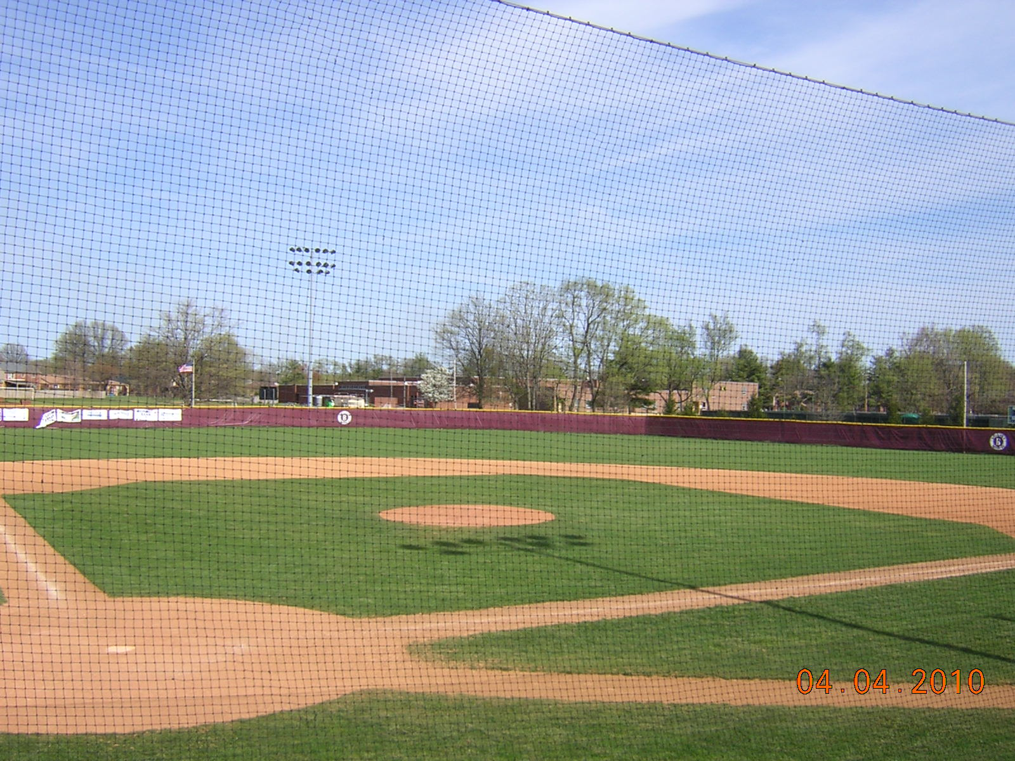
Game Board
1
2
3
4
5
6
7
8
9
10
11
12
13
14
15
16
17
18
19
20

Slide 6
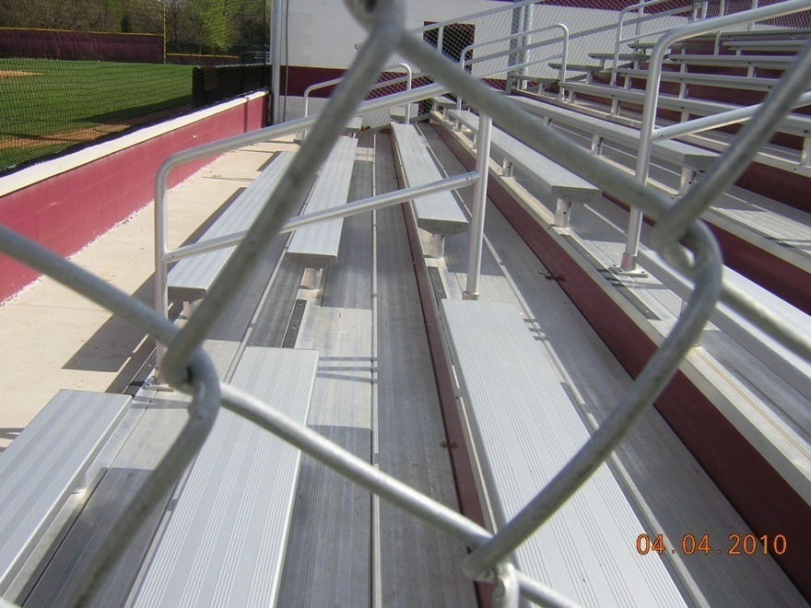
Question 1
Use the Pythagorean Theorem to find the length of the hypotenuse.
2”
2”
(All Sides = 2 inches)

Slide 7
Answer 1
2²+ 2²=X²
X=2.83 inches

Slide 8
Question 2
What is the measure of the two non-right angles of the right triangle?
2”
2”
(All Sides = 2 inches)

Slide 9
Answer 2
45 degrees

Slide 10
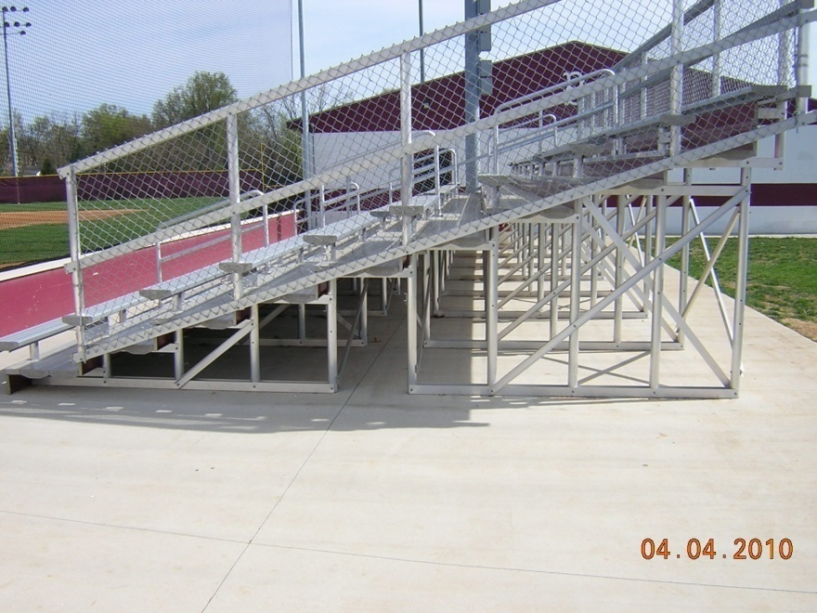
Question 3
What is the length of the hypotenuse?
7’
16’
(Ground Leg=16 feet; Vertical Leg=7 feet)

Slide 11
Answer 3
16²+7²=X²
X=17.46 feet

Slide 12
Question 4
What is the angle opposite the 7 foot side?
7’
16’
(Ground Leg=16 feet; Vertical Leg=7 feet)

Slide 13
Answer 4
tan(a)=7/16
a=23.63 degrees

Slide 14
Question 5
What is the angle opposite the 16 foot side?
7’
16’
(Ground Leg=16 feet; Vertical Leg=7 feet)

Slide 15
Answer 5
tan(b)=16/7
b=66.37 degrees

Slide 16
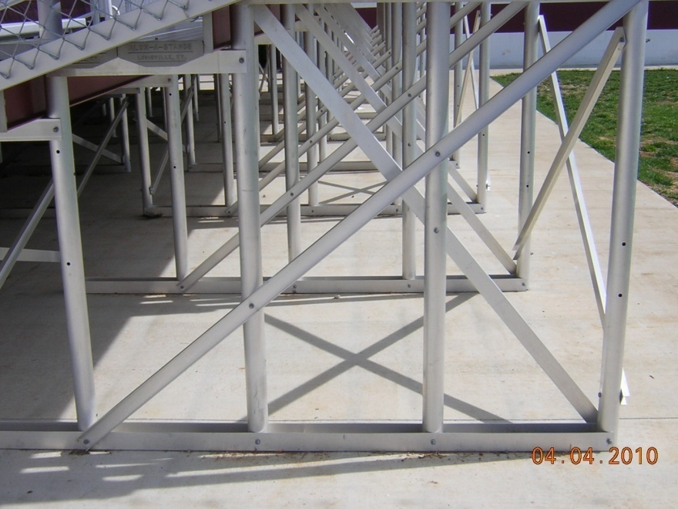
Question 6
What is the length of the vertical leg?
7.81’
6’
(Ground Leg=6 feet; Hypotenuse=7.81 feet)

Slide 17
Answer 6
6²+Y²=(7.81)²
Y=5 feet

Slide 18
Question 7
What is the angle opposite the 6 foot side?
7.81’
6’
(Ground Leg=6 feet; Hypotenuse=7.81 feet)

Slide 19
Answer 7
tan(a)=6/5
a=50.19

Slide 20
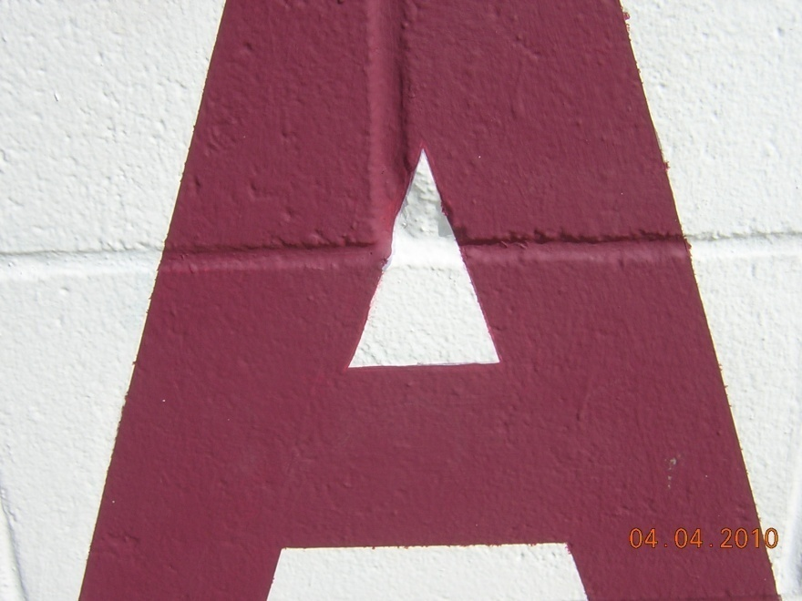
Question 8
What is the measure of the two equal angles?
4”
4”
3”
(Base=3 inches; Other two sides=4 inches)

Slide 21
Answer 8
cos(a)=1.5/4
a=67.98 degrees

Slide 22
Question 9
What is the third (top) angle?
4”
4”
3”
(Base=3 inches; Other two sides=4 inches)

Slide 23
Answer 9
180-(67.98*2)=b
b=44.04 degrees

Slide 24
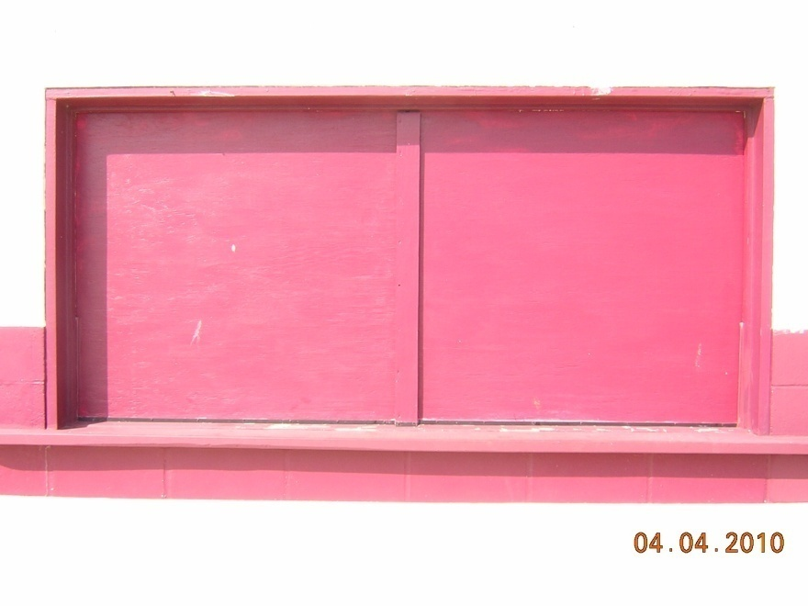
Question 10
Find the length of a diagonal placed from the top left corner to the bottom right corner.
4’
8’
(Base=8 feet; Height=4 feet)

Slide 25
Answer 10
4²+8²=X²
X=8.94 feet

Slide 26
Question 11
What is the angle opposite the 4 foot side?
4’
8’
(Base=8 feet; Height=4 feet)

Slide 27
Answer 11
tan(a)=4/8
a=26.57 degrees

Slide 28
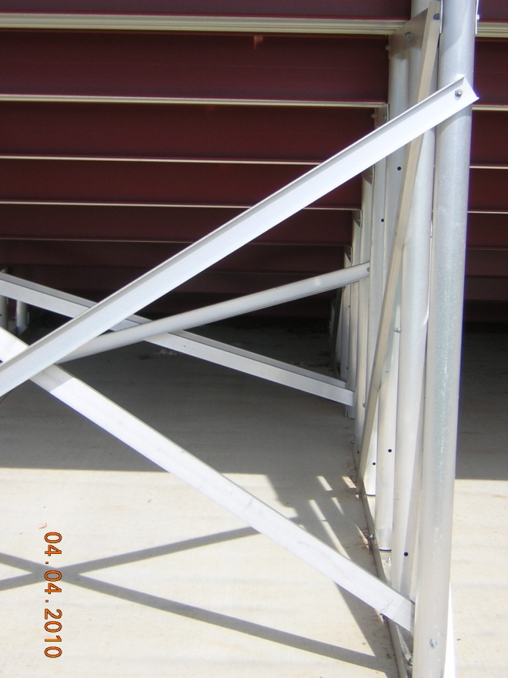
Question 12
3.5’
What is the measure of the two equal angles?
4’
3.5’
(Vertical side=4 feet; other two sides=3.5 feet)

Slide 29
Answer 12
cos(a)=2/3.5
a=55.15 degrees

Slide 30

Question 13
What is the third (left) angle measure?
3.5’
4’
3.5’
(Vertical side=4 feet; other two sides=3.5 feet)

Slide 31
Answer 13
180-(55.15*2)=b
b=69.70 degrees

Slide 32
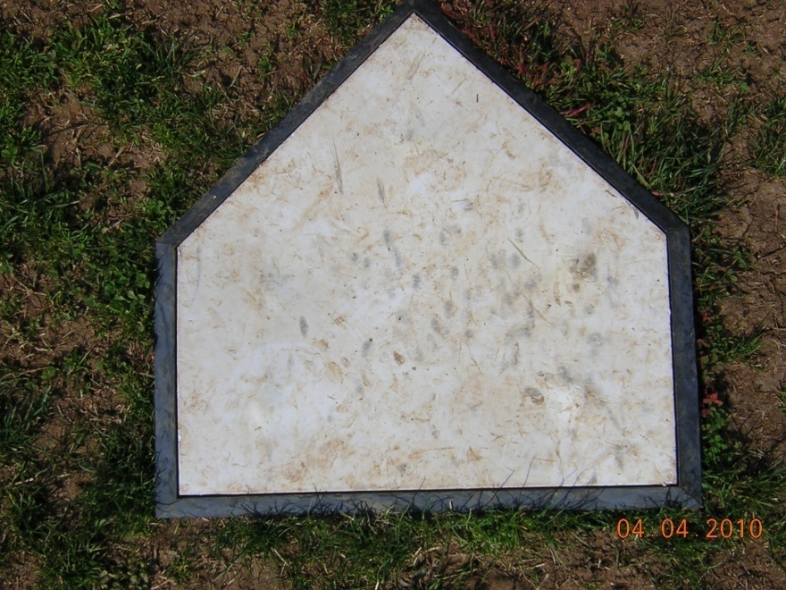
Question 14
1’
1’
What is the measure of the top angle of home plate?
18”
(Diagonal sides=1 foot; Base=18 inches)

Slide 33
Answer 14
sin(a)=9/12; a=48.59; 2*a
angle=97.18 degrees

Slide 34
Question 15
1’
1’
What is the measure of the two equal obtuse angles?
18”
(Diagonal sides=1 foot; Base=18 inches)

Slide 35
Answer 15
180-(90+48.59)=41.41; 41.41+90
angles=131.41 degrees

Slide 36
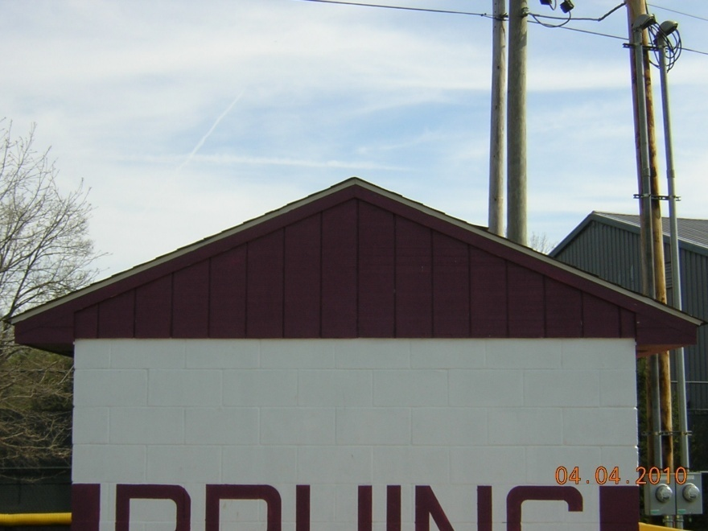
Question 16
What is the measure of the two acute angles?
3’
12’
(Base=12 feet; Height=3 feet)

Slide 37
Answer 16
tan(a)=3/6
a=26.57 degrees

Slide 38
Question 17
What is the measure of the obtuse angle?
3’
12’
(Base=12 feet; Height=3 feet)

Slide 39
Answer 17
90-26.57=63.43; 2*63.43
angle=126.86 degrees

Slide 40
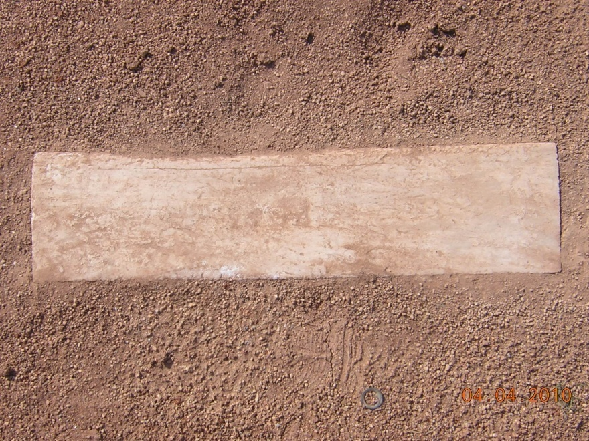
Question 18
What is the length of the height?
24.62”
2’
(Base=2 feet; Diagonal=24.62 inches)

Slide 41
Answer 18
X²+24²=24.62²
X=5.49 inches

Slide 42
Question 19
Looking at the triangle made by the diagonal, what is the angle opposite the 2 foot side.
24.62”
2’
(Base=2 feet; Diagonal=24.62 inches)

Slide 43
Answer 19
sin(a)=24/24.62
a=77.11 degrees

Slide 44

Question 20
What is the length of the diagonal of the cubby from the front, bottom, left to the top, back, right?
(bottom side=16 inches; height=12 inches; depth=10 inches)

Slide 45
Answer 20
12²+18.87²=Y²
Y=22.36 inches

